Slide 1

Хакатон СберТройка
Команда «Мы !умеем кодить»
Notes:
This is the title page. It has the name of your company, and a one line description of what you do.
This is the only place in the deck where you can only have 1 slide for what you need to show. Any of the other slides in this deck should be treated as a first slide of a set. If you can keep the set to n=1, that’s ideal, but if you need more, that’s ok. You probably don’t want any set here where n > 3. This is a seed deck, remember.

Slide 2
Существующая инфраструктура не раскрывает потенциал водных ресурсов города
Река используется в основном для туристических и развлекательных целей
Отсутствует связь между маршрутами судов
Водный транспорт не используется в качестве общественного
Notes:
This is where you clearly state the problem. Particulars of how this problem impacts real world people/businesses are valuable.

Slide 3
Проект «Wetro»
Как метро, только wet
Notes:
This is the solution. You want to explain what you do very clearly, in as few words as possible. Describe the concrete benefits you provide

Slide 4
Река Москва – это МЦД, для которого не надо класть рельсы
Notes:
This is the solution. You want to explain what you do very clearly, in as few words as possible. Describe the concrete benefits you provide

Slide 5
Цели
Использование водных трамваев для создания сети маршрутов, которыми будет удобно пользоваться
Адаптация UI/UX инфраструктуры наземного общественного транспорта
Notes:
This is the solution. You want to explain what you do very clearly, in as few words as possible. Describe the concrete benefits you provide

Slide 6
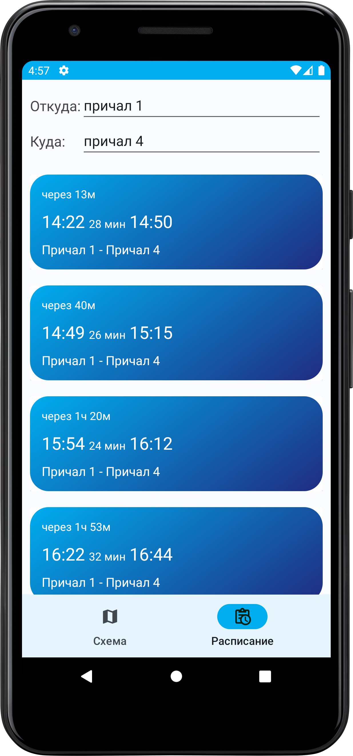
Приложение Wetro
Просмотр схемы маршрутов
Построение мономодальных поездок
Просмотр расписания рейсов
Notes:
This is the solution. You want to explain what you do very clearly, in as few words as possible. Describe the concrete benefits you provide

Slide 7
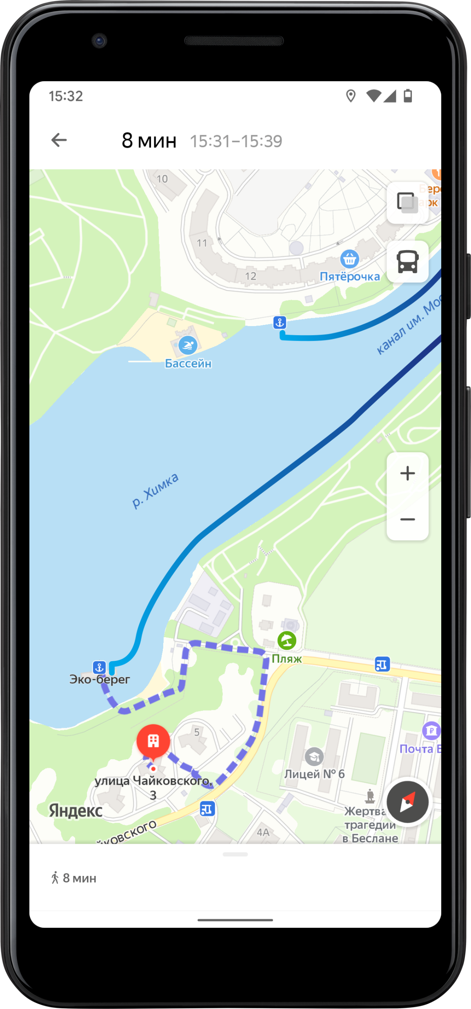
Интеграция с наземным транспортом
Создание мультимодальных поездок
Популяризация водного транспорта
Notes:
This is the solution. You want to explain what you do very clearly, in as few words as possible. Describe the concrete benefits you provide

Slide 8
Развитие
Интеграция и развитие водных мест досуга
Речное такси
Создание приложения для капитанов малых судов
Notes:
This is the solution. You want to explain what you do very clearly, in as few words as possible. Describe the concrete benefits you provide

Slide 9





Команда
Огородников Николай Александрович
Дизайнер
Самсонов Вячеслав Александрович
Android-разработчик
Notes:
This is the solution. You want to explain what you do very clearly, in as few words as possible. Describe the concrete benefits you provide

